Slide 1
Domain Deep Learning
Technology: Python
FRUIT DISEASE DETECTION USING COLOR, TEXTURE ANALYSIS AND ANN

Slide 2

Index
Abstract
Introduction
Literature review
Modules
Results
Conclusion
References
Abstract
Introduction
Literature review
Modules
Results
Conclusion
References

Slide 3
Abstract
Now-a-days as there is prohibitive demand for agricultural industry, effective growth and improved yield of fruit is necessary and important. For this purpose farmers need manual monitoring of fruits from harvest till its progress period. But manual monitoring will not give satisfactory result all the times and they always need satisfactory advice from expert. So it requires proposing an efficient smart farming technique which will help for better yield and growth with less human efforts. We introduce a technique which will diagnose and classify external disease within fruits. Traditional system uses thousands of words which lead to boundary of language.

Slide 4
Whereas system that we have come up with, uses image processing techniques for implementation as image is easy way for conveying. In the proposed work, OpenCV library is applied for implementation. K-means clustering method is applied for image segmentation, the images are catalogue and mapped to their respective disease categories on basis of four feature vectors color, morphology, texture and structure of hole on the fruit. The system uses two image databases, one for implementation of query images and the other for training of already stored disease images. Artificial Neural Network (ANN) concept is used for pattern matching and classification of diseases.

Slide 5
Introduction
The studies of fruit or plant can be determined by observable patterns of specific plant and it is critical to monitor health and detect disease within a plant. Through proper management strategies such as pesticides, fungicides and chemical applications one can facilitates control of diseases which interns improve quality.
The purpose of this paper is to monitor diseases on fruits and suggest better solution for healthy yield and productivity with the help of Artificial Neural Network concept. System uses two image databases, one for training of already stored infected area image and other for execution of query images.

Slide 6
Three fruits namely grapes, apple and pomegranate have been used for research in this paper. Types of fruits and their respective diseases are as follows: [1] 1. Grapes: a) Black Rot: For grapes, black rot is most widely occurring and severe disease. In this disease, fungus attacks canes, tendrils, leaves and fruit and it is most devastating in hot and moist areas.
Now-a-days using combination of sound cultural practices, fungicides and resistant varieties it is possible to control black rot. First sign of black rot is visible on leaves as black border forms around the edge and small yellowish spot is formed, after that spots enlarges.

Slide 7
Literature review
[1] Sudhir Rao Rupanagudi, Ranjani B.S., Prathik Nagaraj ,Varsha G. Bhat “A Cost Effective Tomato Maturity Grading System using Image Processing for Farmers” International Conference on Contemporary Computing and Information ,2014.T.
Maturity grading or in other words classifying the ripeness of a fruit, based on its color or texture, forms a very important process to be carried out by agriculturists and the food processing industry worldwide. Current techniques mainly involve manual inspection, which leads to erroneous classification, which in turn would cause economical losses due to inferior produce entering the market chain. A loss of yield during storage may also occur with this type of classification, since it would lead to wrong expiry date predictions as well.

Slide 8
[2] Manisha A. Bhange, Prof. H. A. Hingoliwala “A Review of Image Processing for Pomegranate Disease Detection” International Journal of Computer Science and Information Technologies, Vol. 6 (1), 2015, 92-94.
In this paper, we suggest a solution for the detection of pomegranate fruit disease (bacterial blight) and also the solution for that disease after detection is proposed. Bacterial Blight need to control at primary stages otherwise it will lead to economic loss. Web-based system used to help non experts in identifying fruit diseases, based on the picture representing the symptoms of the fruit. Farmers can take the photo of the fruit disease and upload it to the system. Then system will show to the farmer is the fruit is infected by the bacterial blight or not. We have added new approach of IntentSearch in this system that is useful when quality of input image is poor. The image processing based proposed system uses two image databases, one for training and other for testing.

Slide 9
[3] Savita N. Ghaiwat, Parul Arora “Detection and Classification of Plant Leaf Diseases Using Image processing Techniques: A Review” International Journal of Recent Advances in Engineering & Technology (IJRAET) ISSN (Online): 2347 - 2812, Volume-2, Issue - 3, 2014.
This paper present survey on different classification techniques that can be used for plant leaf disease classification. A classification technique deals with classifying each pattern in one of the distinct classes. A classification is a technique where leaf is classified based on its different morphological features. There are so many classification techniques such as k-Nearest Neighbour Classifier, Probabilistic Neural Network, Genetic Algorithm, Support Vector Machine, and Principal Component Analysis, Artificial neural network, Fuzzy logic. Selecting a classification method is always a difficult task because the quality of result can vary for different input data.

Slide 10
[4] Rashmi Pandey, Sapan Naik, Roma Marfatia “Image Processing and Machine Learning for Automated Fruit Grading System: A Technical Review” International Journal of Computer Applications (0975 – 8887) Volume 81 – No 16, November 2013.
In India, demand for various fruits and vegetables are increasing as population grows. Automation in agriculture plays a vital role in increasing the productivity and economical growth of the Country, therefore there is a need for automated system for accurate, fast and quality fruits determination. Researchers have developed numerous algorithms for quality grading and sorting of fruit. Color is most striking feature for identifying disease and maturity of the fruit. In this paper; efficient algorithms for color feature extraction are reviewed. Then after, various classification techniques are compared based on their merits and demerits. current work reported on an automatic fruit grading system.

Slide 11
[5] Anand H. Kulkarni, Ashwin Patil R. K. “Applying image processing technique to detect plant diseases” International Journal of Modern Engineering Research (IJMER) Vol.2, Issue.5, Sep-Oct. 2012 pp3661-3664 .
This paper presents a survey on methods that use digital image processing techniques to detect, quantify and classify plant diseases from digital images in the visible spectrum. Although disease symptoms can manifest in any part of the plant, only methods that explore visible symptoms in leaves and stems were considered. This was done for two main reasons: to limit the length of the paper and because methods dealing with roots, seeds and fruits have some peculiarities that would warrant a specific survey. The selected proposals are divided into three classes according to their objective: detection, severity quantification, and classification. Each of those classes, in turn, are subdivided according to the main technical solution used in the algorithm.

Slide 12
[6] Hetal N. Patel, Dr. M. V. Joshi “Fruit Detection using Improved Multiple Features based Algorithm” International Journal of Computer Applications (0975 – 8887), Volume 13– No.2, January 2011.
Efficient locating the fruit on the tree is one of the major requirements for the fruit harvesting system. This paper presents the fruit detection using improved multiple features based algorithm. To detect the fruit, an image processing algorithm is trained for efficient feature extraction. The algorithm is designed with the aim of calculating different weights for features like intensity, color, orientation and edge of the input test image. The weights of different features represent the approximate locations of the fruit within an image. The Detection Efficiency is achieved up to 90% for different fruit image on tree, captured at different positions. The input images are the section of tree image. The proposed approach can be applied for targeting fruits for robotic fruit harvesting.

Slide 13
[7] H. Al-Hiary, S. Bani-Ahmad, M. Reyalat, M. Braik and Z. ALRahamneh “Fast and Accurate Detection and Classification of Plant Diseases” International Journal of Computer Applications (0975 – 8887) Volume 17– No.1, March 2011.
We propose and experimentally evaluate a software solution for automatic detection and classification of plant leaf diseases. The proposed solution is an improvement to the solution proposed in as it provides faster and more accurate solution. The developed processing scheme consists of four main phases as in [1]. The following two steps are added successively after the segmentation phase. In the first step we identify the mostly-green colored pixels. Next, these pixels are masked based on specific threshold values that are computed using Otsu's method, then those mostly green pixels are masked. The other additional step is that the pixels with zeros red, green and blue values and the pixels on the boundaries of the infected cluster (object) were completely removed.

Slide 14
[8] Anshuka Srivastava, Swapnil Kumar Sharma “Development of a Robotic Navigator to Assist the Farmer in Field” Proceeding of the International Multi Conference of Engineers and Computer Scientists 2010 Vol. (2) IMECS 2010 March 17-19, Hong Kong.
This paper reports on development of a robotic navigator, "Robo Kisan", developed to assist the farmer in the crop field and show the complete function of the sensor for crop disease detection. This robotic navigator equipped with sensors for automatic mobility in the crop field is developed in two folds: Hardware design and Software design. A short description of the sensor for crop disease detection along with the navigator hardware and software are described in detail. The goal of the present design of the navigator is to make it carry sensors and other tools as per requirement to help the farmer in detecting the disease and other repetitive jobs.

Slide 15
[9] Pradnya Ravindra Narvekar, Mahesh Manik Kumbhar2, S. N. Patil “Grape Leaf Diseases Detection & Analysis using SGDM Matrix Method” International Journal of Innovative Research in Computer and Communication Engineering (An ISO 3237:2007 certified organization )
Producing Grape is a daunting task as the plant is exposed to the attacks from various micro organisms ,bacterial diseases and pests .The symptoms of the attacks are usually distinguished through the leaves ,stems or fruit inspection . This proposed system discusses the effective way used in performing detection of grape diseases through leaf feature inspection. Leaf image is captured and proposed to determine the health status of each plant. Plant disease diagnosis is an art as well as science. The diagnosis process (i.e. recognition of symptoms and signs), is inherently visual and requires intuitive judgement as well as the use of scientific methods. Photographic images of symptoms and signs of plant’s diseases used extensively to enhance description of plant diseases are invaluable in research, diagnostics etc

Slide 16
Problem Statement
Detecting blight in pomegranate, disease in plants using leaves and grapes cause by various micro organisms and bacteria is an important task in modern world. Sensors like camera, Temperature reader, Humidity readers etc.. can be extensively used to detect such diseases efficiently and faster than manual detection. Many Machine learning and Deep learning techniques can be used for disease detection as well. They provide faster, cheaper and highly scalable solution for disease detection.

Slide 17
Implementation
SystemSystem
1.1 Create Dataset:
The dataset containing fruit images of the desired objects to be recognize is split into training and testing dataset with the test size of 20-30%.
1.2 Pre-processing:
Resizing, gray scaling and reshaping the images into appropriate format to train our model. The final dataset is split into training and testing dataset with test size of 10%.
1.3Training:
Use the pre-processed training dataset to train our model using ANN algorithm.

Slide 18
User:
2.1 Register
The user needs to register and the data stored in MySQL database.
2.2 About-Project
In this application, we have successfully created an application which takes a fruit image for classify the fruit diseases.

Slide 19
2.2 Login
A registered user can login using the valid credentials to the website to use a application.
2.4 Upload Image
The user has to upload an image which needs to be tested for fruit diseases.
2.5 Prediction
The results of our model is displayed as either apple blotch, apple scab, aspergillums fruit rot, bacterial blight, black rot, downy mildew, gray mold, powdery mildew and rotten apples.
2.6 Logout
Once the prediction is over, the user can logout of the application.

Slide 20
System design:
USE CASE DIAGRAM:
A use case diagram in the Unified Modeling Language (UML) is a type of behavioral diagram defined by and created from a Use-case analysis. Its purpose is to present a graphical overview of the functionality provided by a system in terms of actors, their goals (represented as use cases), and any dependencies between those use cases. The main purpose of a use case diagram is to show what system functions are performed for which actor. Roles of the actors in the system can be depicted.

Slide 21
CLASS DIAGRAM:
In software engineering, a class diagram in the Unified Modeling Language (UML) is a type of static structure diagram that describes the structure of a system by showing the system's classes, their attributes, operations (or methods), and the relationships among the classes. It explains which class contains information.

Slide 22
SEQUENCE DIAGRAM:
A sequence diagram in Unified Modeling Language (UML) is a kind of interaction diagram that shows how processes operate with one another and in what order. It is a construct of a Message Sequence Chart. Sequence diagrams are sometimes called event diagrams, event scenarios, and timing diagrams.

Slide 23
Collaboration Diagram:
In collaboration diagram the method call sequence is indicated by some numbering technique as shown below. The number indicates how the methods are called one after another. We have taken the same order management system to describe the collaboration diagram. The method calls are similar to that of a sequence diagram. But the difference is that the sequence diagram does not describe the object organization whereas the collaboration diagram shows the object organization.

Slide 24
DEPLOYMENT DIAGRAM
Deployment diagram represents the deployment view of a system. It is related to the component diagram. Because the components are deployed using the deployment diagrams. A deployment diagram consists of nodes. Nodes are nothing but physical hardware’s used to deploy the application.

Slide 25
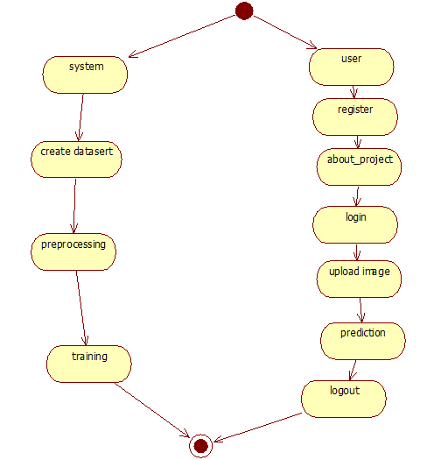
ACTIVITY DIAGRAM:
Activity diagrams are graphical representations of workflows of stepwise activities and actions with support for choice, iteration and concurrency. In the Unified Modeling Language, activity diagrams can be used to describe the business and operational step-by-step workflows of components in a system. An activity diagram shows the overall flow of control.

Slide 26
Component diagram,
A component diagram, also known as a UML component diagram, describes the organization and wiring of the physical components in a system. Component diagrams are often drawn to help model implementation details and double-check that every aspect of the system's required functions is covered by planned development.

Slide 27
ER Diagram:
An Entity–relationship model (ER model) describes the structure of a database with the help of a diagram, which is known as Entity Relationship Diagram (ER Diagram). An ER model is a design or blueprint of a database that can later be implemented as a database. The main components of E-R model are: entity set and relationship set.
An ER diagram shows the relationship among entity sets. An entity set is a group of similar entities and these entities can have attributes. In terms of DBMS, an entity is a table or attribute of a table in database, so by showing relationship among tables and their attributes, ER diagram shows the complete logical structure of a database. Let’s have a look at a simple ER diagram to understand this concept.

Slide 28
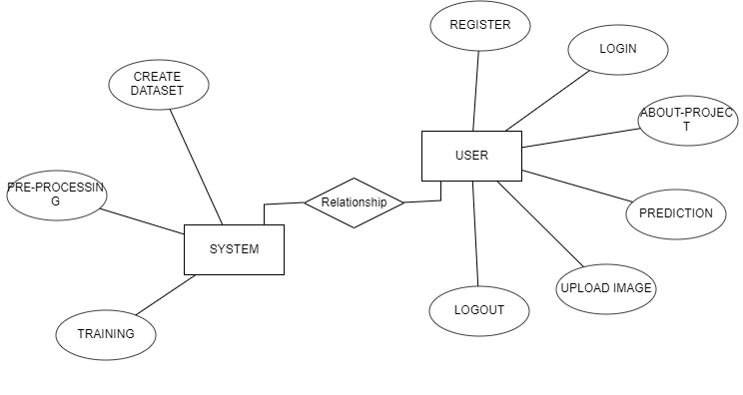

Slide 29
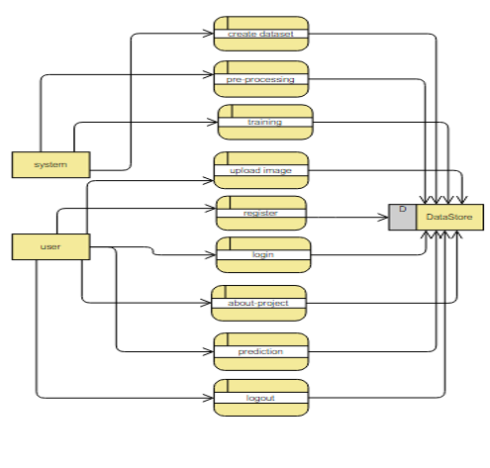
DFD Diagram:
A Data Flow Diagram (DFD) is a traditional way to visualize the information flows within a system. A neat and clear DFD can depict a good amount of the system requirements graphically. It can be manual, automated, or a combination of both. It shows how information enters and leaves the system, what changes the information and where information is stored. The purpose of a DFD is to show the scope and boundaries of a system as a whole. It may be used as a communications tool between a systems analyst and any person who plays a part in the system that acts as the starting point for redesigning a system.

Slide 30
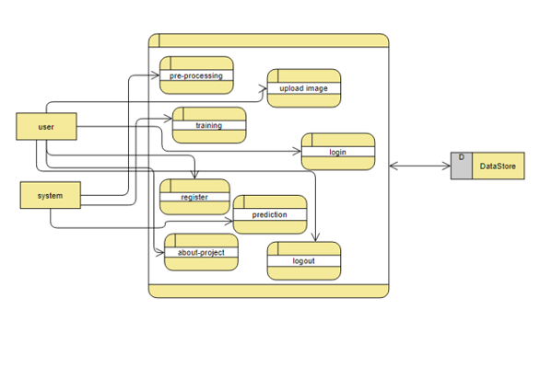

Slide 31
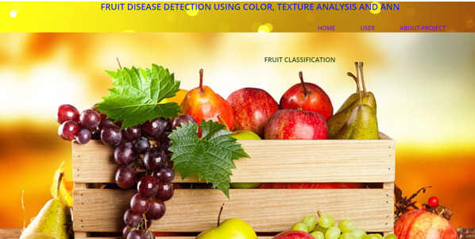
Results(Input)
Home page:

Slide 32
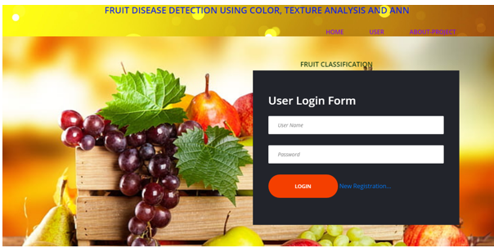
User Login Page:

Slide 33
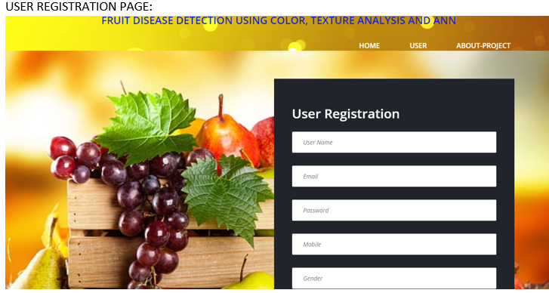

Slide 34
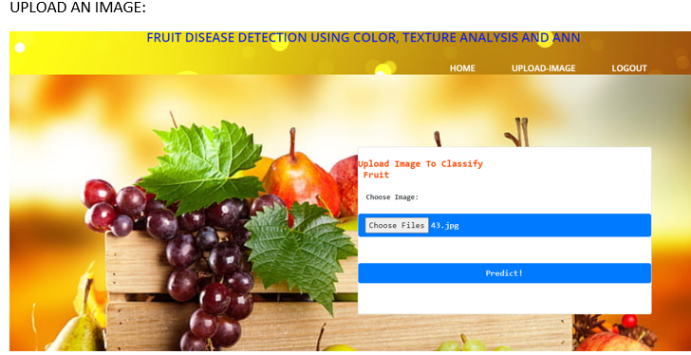

Slide 35
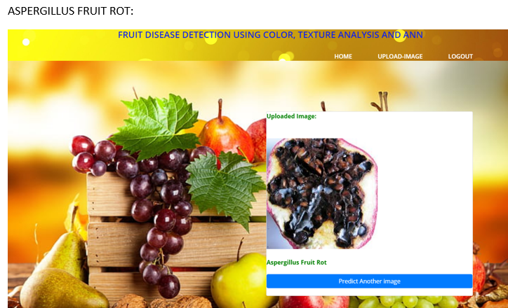

Slide 36
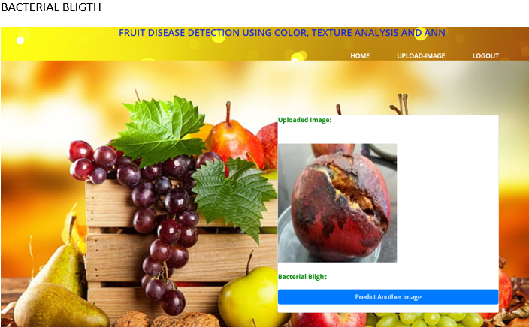

Slide 37
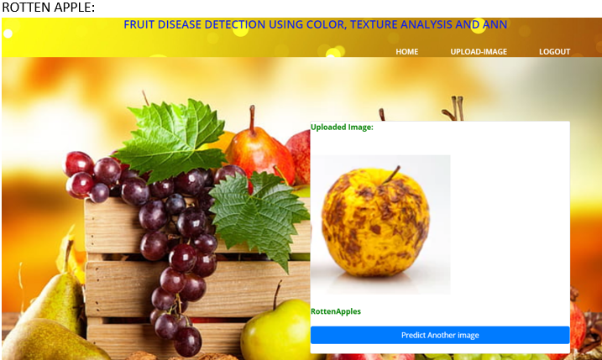

Slide 38
Conclusion:
The innovative outcome suggests that the advanced approach is a worth, which can distinctly support an accurate diagnosis of fruit diseases in a minor computational effort. It also dedicates future study on automatically estimating the severity of the disease.
An image processing derived solution is proposed for detection of grape, apple and pomegranate fruit disease. For Grape -Black Rot, Powdery Mildew, Downy Mildew; For Apple -Apple Scab, Apple Rot, Apple Blotch; For Pomegranate -Bacterial Blight, Aspergillus Fruit Rot, Gray Mold diseases are detected and classified. Once diseases are detected proper treatments are suggested accordingly.

Slide 39
It would also promote Indian Farmers to do smart farming which helps to take time to time decisions which also save time and reduce loss of fruit due to diseases. The leading objective of our paper is to enhance the value of automatic fruit disease detection.

Slide 40
Future Work
This application can be embedded in IOT and other autonomous farming system. Such a system allows for faster harvesting and better fruit safety.

Slide 41
References:
[1] Monica Jhuria, Ashwini Kumar, Rushikesh Borse “Image Processing for Smart Farming: Detection of Disease and Fruit Grading” Proceeding of the 2013 IEEE Second International Conference on Image Processing.
[2] Sudhir Rao Rupanagudi, Ranjani B.S., Prathik Nagaraj ,Varsha G. Bhat “A Cost Effective Tomato Maturity Grading System using Image Processing for 974 2015 International Conference on Green Computing and Internet of Things (ICGCIoT) Farmers” International Conference on Contemporary Computing and Information ,2014.
[3] Shiv Ram Dubey, Anand Singh Jalal “Adapted Approach for Fruit Disease Identification using Images”.

Slide 42
[4] Manisha A. Bhange, Prof. H. A. Hingoliwala “A Review of Image Processing for Pomegranate Disease Detection” International Journal of Computer Science and Information Technologies, Vol. 6 (1), 2015, 92-94.
[5] Hetal N. Patel, Dr. M. V. Joshi “Fruit Detection using Improved Multiple Features based Algorithm” International Journal of Computer Applications (0975 – 8887), Volume 13– No.2, January 2011.
[6] Abraham Gastélum-Barrios, Rafael A. BorquezLópez, Enrique Rico-García, Manuel ToledanoAyala and Genaro M. Soto-
* “Tomato Quality Evaluation with Image processing: A review” African Journal of Agricultural Research Vol. 6(14), pp. 3333-3339, 18 July, 2011.

Slide 43


